Slide 1
Fridge Maintenance Sub-System
Mnqobi Sibisi
s224274104

Slide 2
Maintenance
DJ
Doe, John (User)
View Upcoming Maintenance Visits View Maintenance History Tips & Troubleshooting
Keep your fridge running smoothly
View upcoming maintenance visits, and access troubleshooting tips all in one place.
Back
Next
ChillTech Solutions 2024
This Photo by Unknown Author is licensed under CC BY

Slide 3
Maintenance
DJ
Doe, John (User)
View Upcoming Maintenance Visits View Maintenance History Tips & Troubleshooting
Keep your fridge running smoothly
View upcoming maintenance visits, and access troubleshooting tips all in one place.
Next
Back
ChillTech Solutions 2024
This Photo by Unknown Author is licensed under CC BY

Slide 4
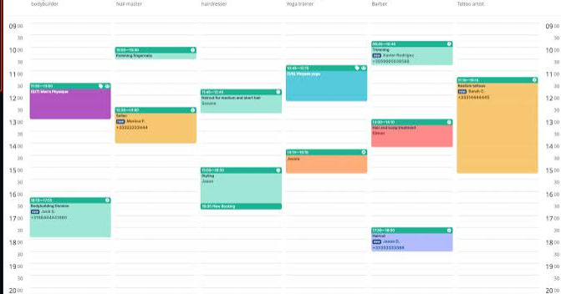
Upcoming Visits
DJ
Doe, John (User)
Keep your fridge running smoothly
View upcoming maintenance visits, and access troubleshooting tips all in one place.
Back
ChillTech Solutions 2024
This Photo by Unknown Author is licensed under CC BY

Slide 5
Maintenance
DJ
Doe, John (User)
View Upcoming Maintenance Visits View Maintenance History Tips & Troubleshooting
Keep your fridge running smoothly
View upcoming maintenance visits, and access troubleshooting tips all in one place.
Next
Back
ChillTech Solutions 2024
This Photo by Unknown Author is licensed under CC BY

Slide 6
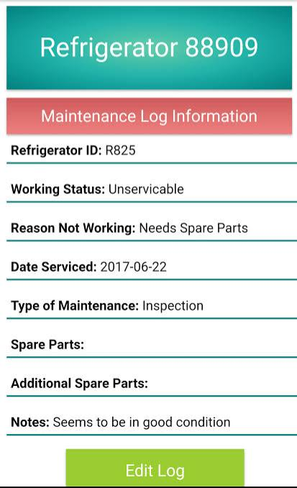
View Maintenance History
DJ
Doe, John (User)
Next
ChillTech Solutions 2024
This Photo by Unknown Author is licensed under CC BY

Slide 7
Maintenance
DJ
Doe, John (User)
View Upcoming Maintenance Visits View Maintenance History Tips & Troubleshooting
Keep your fridge running smoothly
View upcoming maintenance visits, and access troubleshooting tips all in one place.
Next
ChillTech Solutions 2024
This Photo by Unknown Author is licensed under CC BY

Slide 8
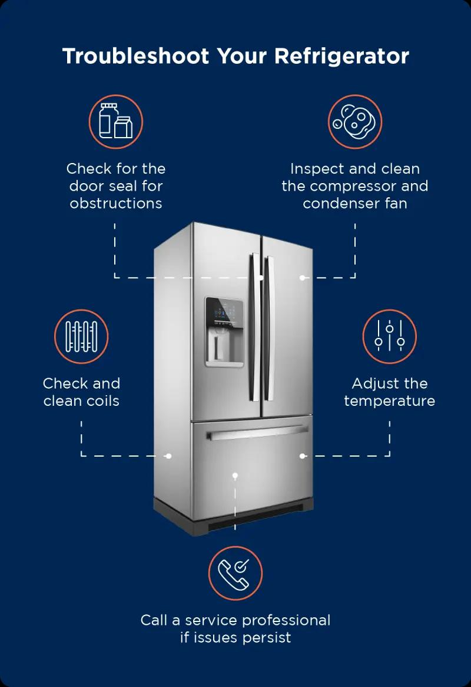
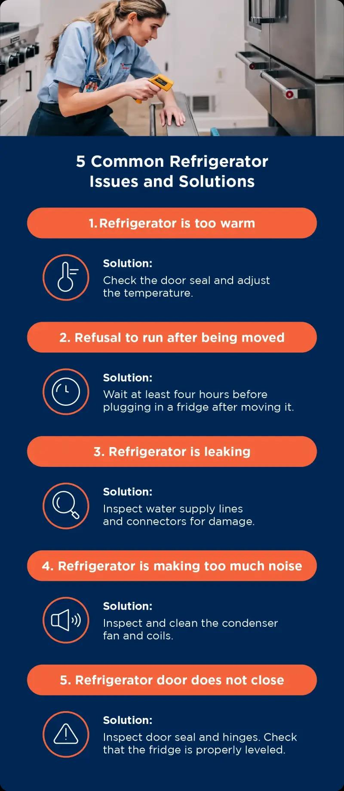
Tips & Troubleshooting
DJ
Doe, John (User)
Back
ChillTech Solutions 2024
This Photo by Unknown Author is licensed under CC BY

Slide 9
Maintenance
DJ
Doe, John (User)
View Upcoming Maintenance Visits View Maintenance History Tips & Troubleshooting
Keep your fridge running smoothly
View upcoming maintenance visits, and access troubleshooting tips all in one place.
Back
Next
ChillTech Solutions 2024
This Photo by Unknown Author is licensed under CC BY

Slide 10
Technician Login
DJ
Doe, John (Tech)
Welcome Back!
Login
Back
ChillTech Solutions 2024
This Photo by Unknown Author is licensed under CC BY

Slide 11
Technician Login
DJ
Doe, John (Tech)
Welcome Back!
Login
Back
ChillTech Solutions 2024
This Photo by Unknown Author is licensed under CC BY

Slide 12
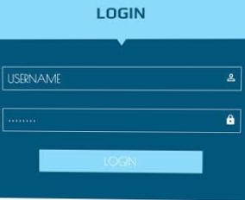
Technician Login
DJ
Doe, John (Tech)
Back
ChillTech Solutions 2024
This Photo by Unknown Author is licensed under CC BY

Slide 13
Maintenance Scheduling
DJ
Doe, John (Tech)
View Upcoming Visits Schedule New Visits Visit and Fault Report
Back
Next
ChillTech Solutions 2024
This Photo by Unknown Author is licensed under CC BY

Slide 14
Upcoming Visits
DJ
Doe, John (Tech)
Bh
Back
Next
ChillTech Solutions 2024
This Photo by Unknown Author is licensed under CC BY

Slide 15
Maintenance Scheduling
DJ
Doe, John (Tech)
View Upcoming Visits Schedule New Visits Visit and Fault Report
Back
Next
ChillTech Solutions 2024
This Photo by Unknown Author is licensed under CC BY

Slide 16
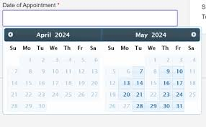
New Visits
DJ
Doe, John (Tech)
Bh
Please Schedule New visits.
Back
Next
ChillTech Solutions 2024
This Photo by Unknown Author is licensed under CC BY

Slide 17
DJ
Doe, John (Tech)
NEW VISIT IS SCHEDULED!
Next
Back
ChillTech Solutions 2024
This Photo by Unknown Author is licensed under CC BY

Slide 18
Maintenance Scheduling
DJ
Doe, John (Tech)
View Upcoming Visits Schedule New Visits. Visit and Fault Report
Back
Next
ChillTech Solutions 2024
This Photo by Unknown Author is licensed under CC BY

Slide 19
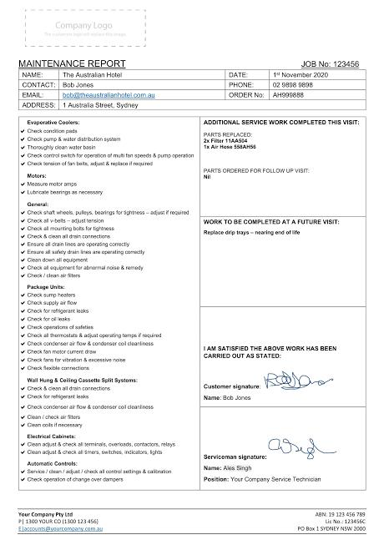
Visit and Fault Report
DJ
Doe, John (Tech)
Bh
Back
Next
ChillTech Solutions 2024
This Photo by Unknown Author is licensed under CC BY

Slide 20
The End.
Thank you

